Slide 1
DATA SCIENCE PROJECT

Slide 2
TEAM R2
OGUNDIPE DANIEL
AIGBE DOUGLAS
OGIERIAKHI CHARLES
IGBADUMHE JOSHUA
TUTOR
AKINNIYI(MAZI)

Slide 3
PROJECT TOPIC
CUSTOMER SEGMENTATION AND IMPROVING STRATEGY FOR A MARKETING TEAM

Slide 4
INTRODUCTION

Slide 5
We own a supermarket mall, through customers records we have some basic data about your customers like Age, Gender, Annual income, and Spending scores (base on customer behaviour on purchasing data).
This data set is created only for learning purpose of the customers segmentation concepts; also known as basket analysis.

Slide 6
PROBLEM STATEMENT
You own the mall and want to understand the customers like who can easily be converge(target customers) so that the sense can be given to marketing team and plan the strategy accordingly.

Slide 7
OBJECTIVES
To be able to suggest the kind of product for a customer based on their income as regard their spending.
To see trend of products customers buy so as to stock more
To be able to identify the kind of customers for your marketing team.

Slide 8
DATA SOURCE
The data was gotten from kaggle.com
Link to data used----> https://www.kaggle .com/vjcoudhary7/customer-segmentation-tutorial-in-python

Slide 9
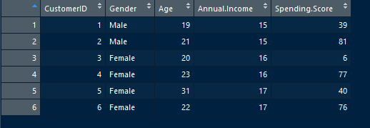
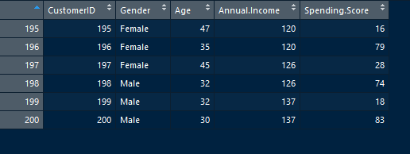
A brief of the data

Slide 10
METHODOLOGY / PROCESS
Sourced the data.
Imported it to the workspace.
Tidied the data(arranged ,filtered (to segment customers based on their Income and spending)).
Transformed it into a graph(histogram ) for visualization.

Slide 11
DATA ANALYSIS

Slide 12
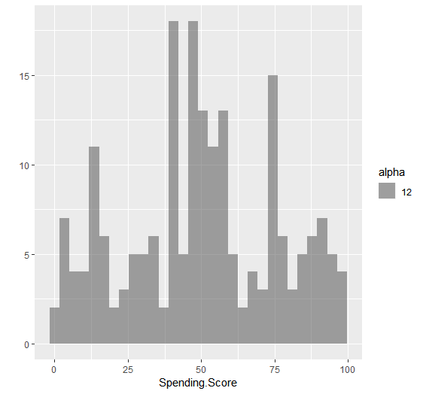
Fig1:Customers data segmentation

Slide 13
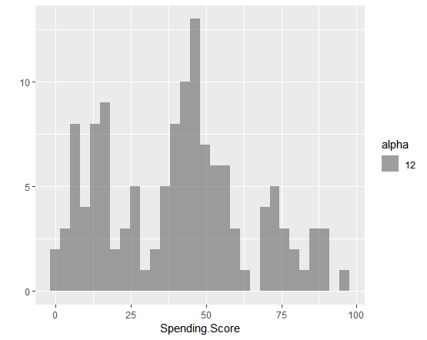
Fig2:Customers data segmentation based on Spending score

Slide 14
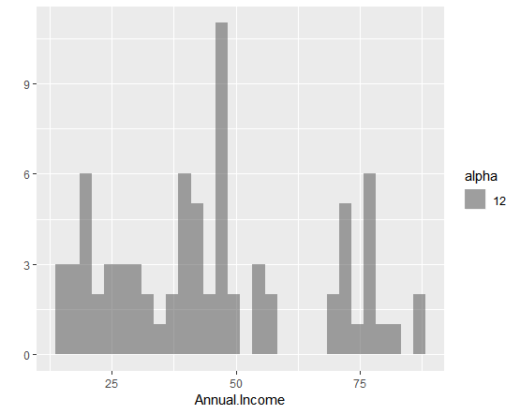
Fig2:Customers data segmentation based on Annual Income

Slide 15
CONCLUSION / RECOMMENDATION
With the data gathered so far, It was discovered that the spending score of the customer was high at a particular range.
It was discovered that customers with high annual income spend less while majority of the low income earners spend more.
From this goods to stock more was discovered and the category of customers our marketing team should approach.
With this, budget can be maximized and losses reduced.

Slide 16
THANK YOU

